Slide 1
Relative Importance of Golf Courses for Bats Influenced by Landscape Context in Northeastern U.S.
Evan Drake
Brooke Maslo
Department of Ecology, Evolution and Natural Resources, Rutgers, The State University of New Jersey

Slide 2
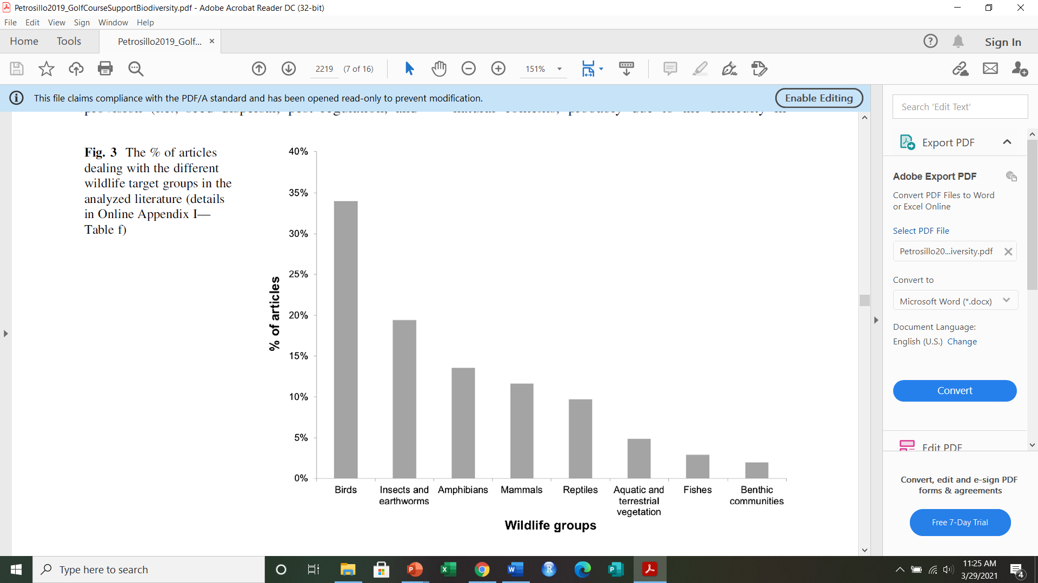

Wildlife Studies on Golf Courses
~ 55%

Slide 3
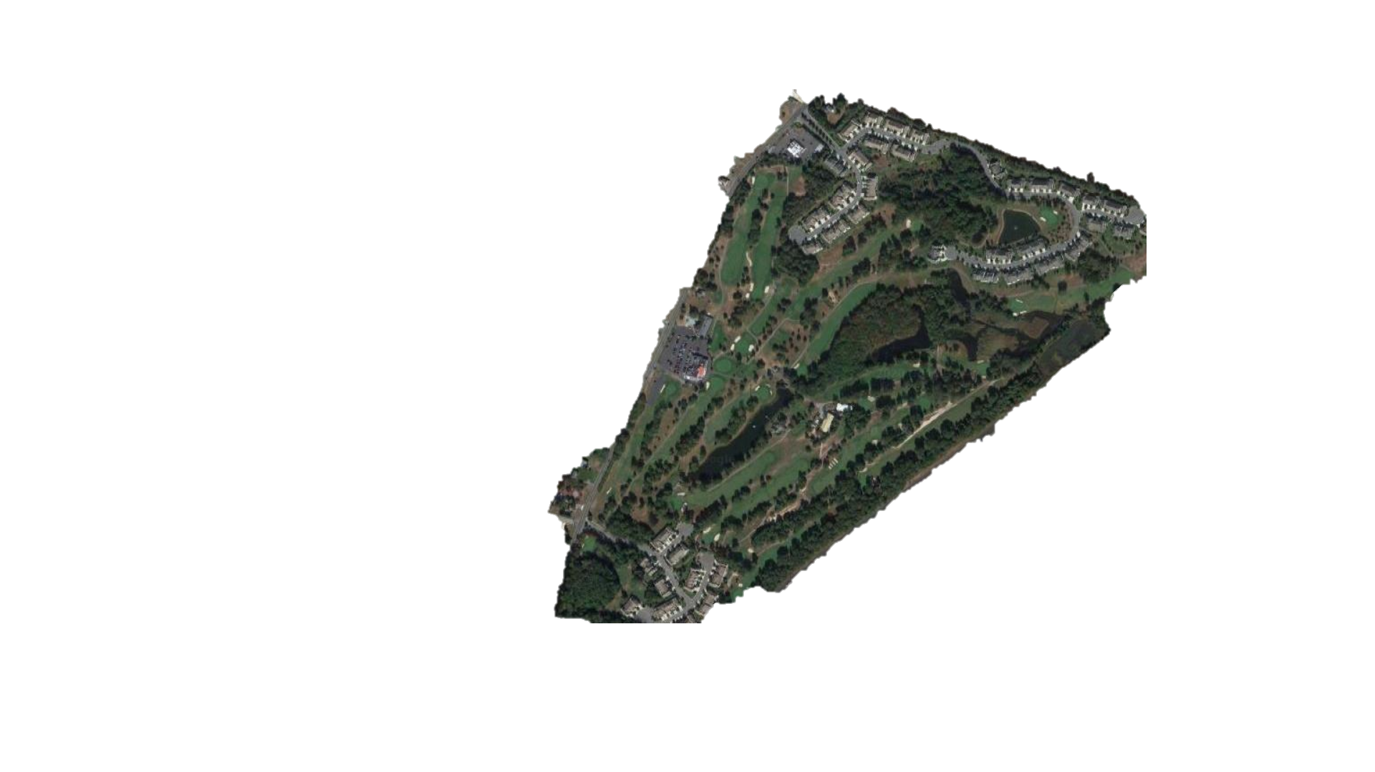
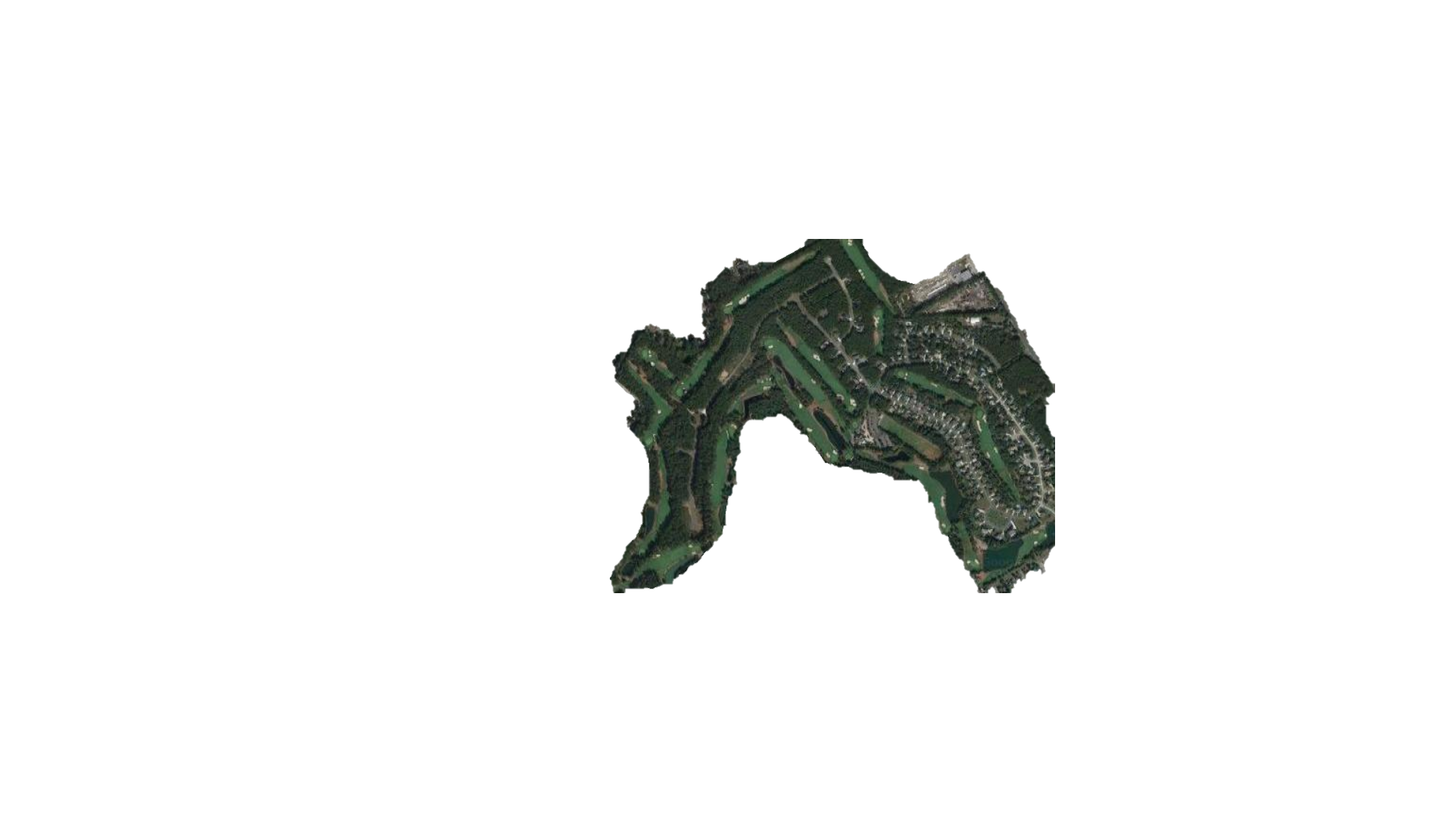
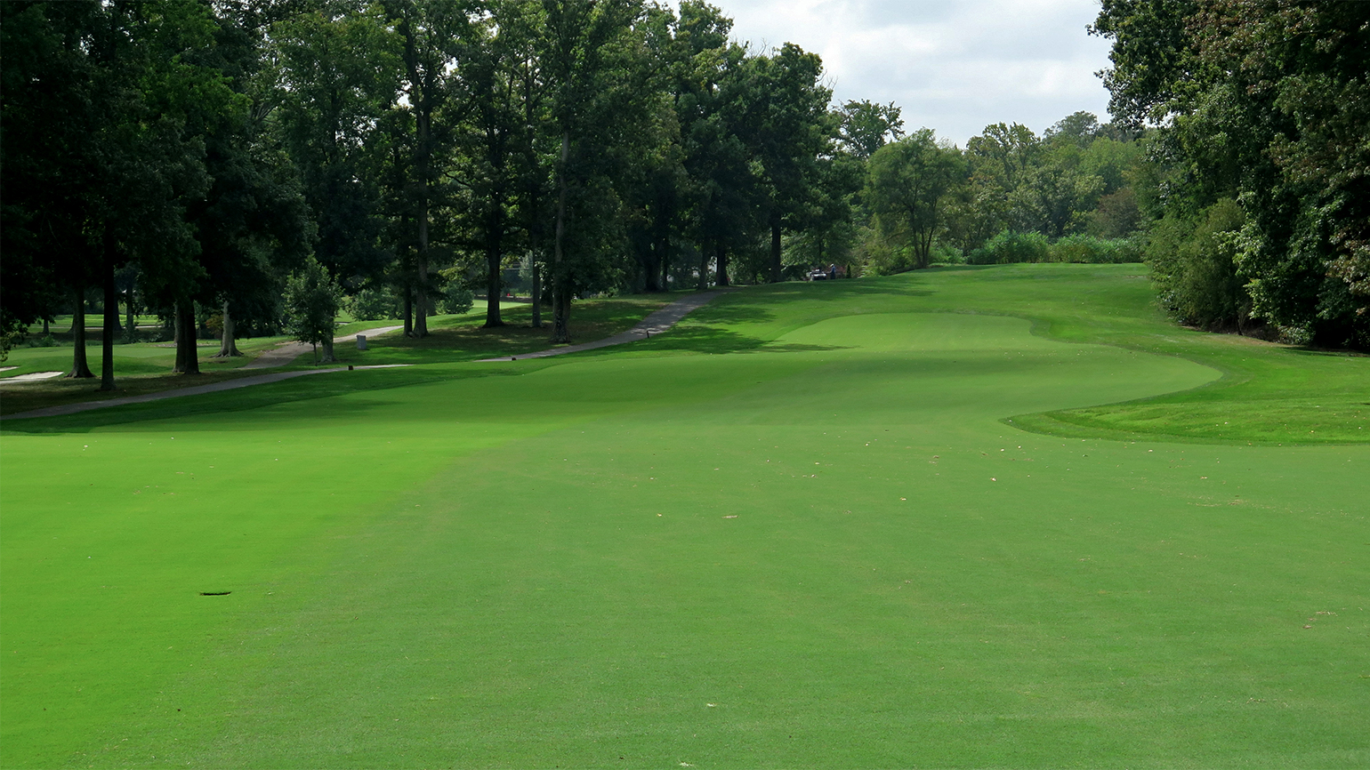
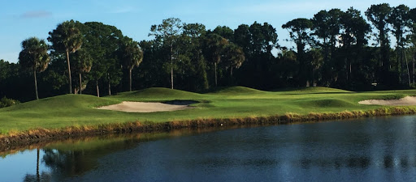

Golf Course = Habitat Patch
Similar in…
Size
Features
Plant species
Security
Maintenance regime
Differ in surrounding matrix

Slide 4
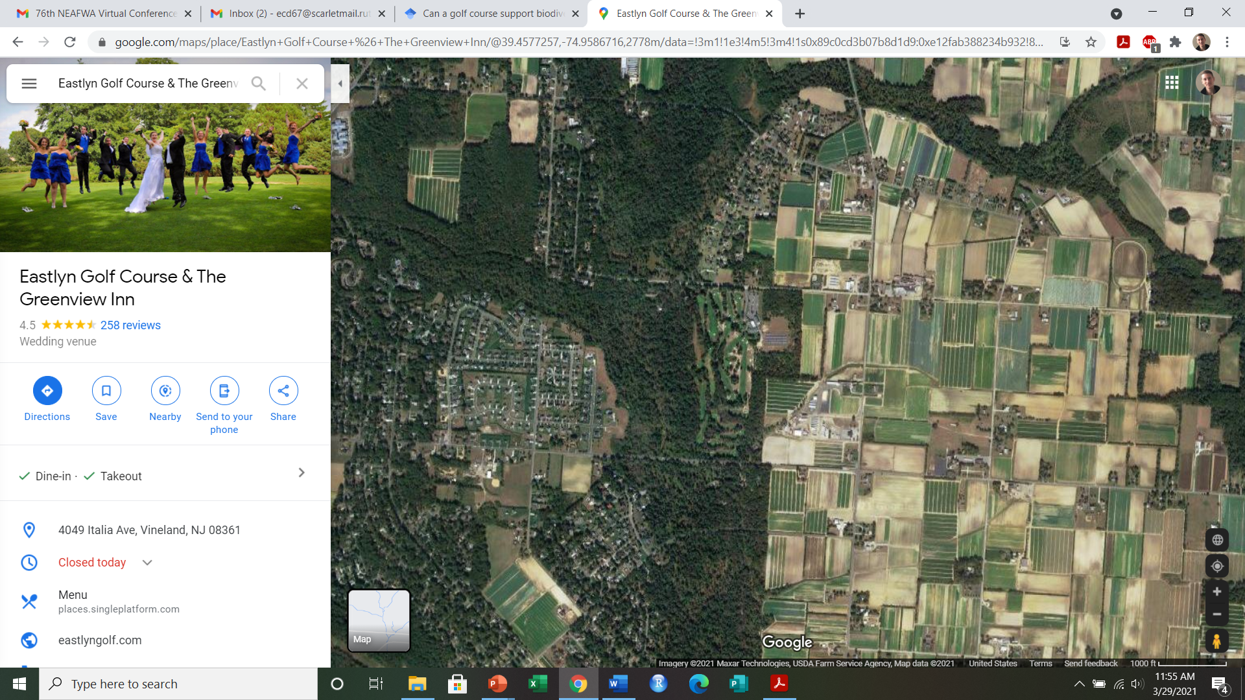
Landscape Matrix

Slide 5
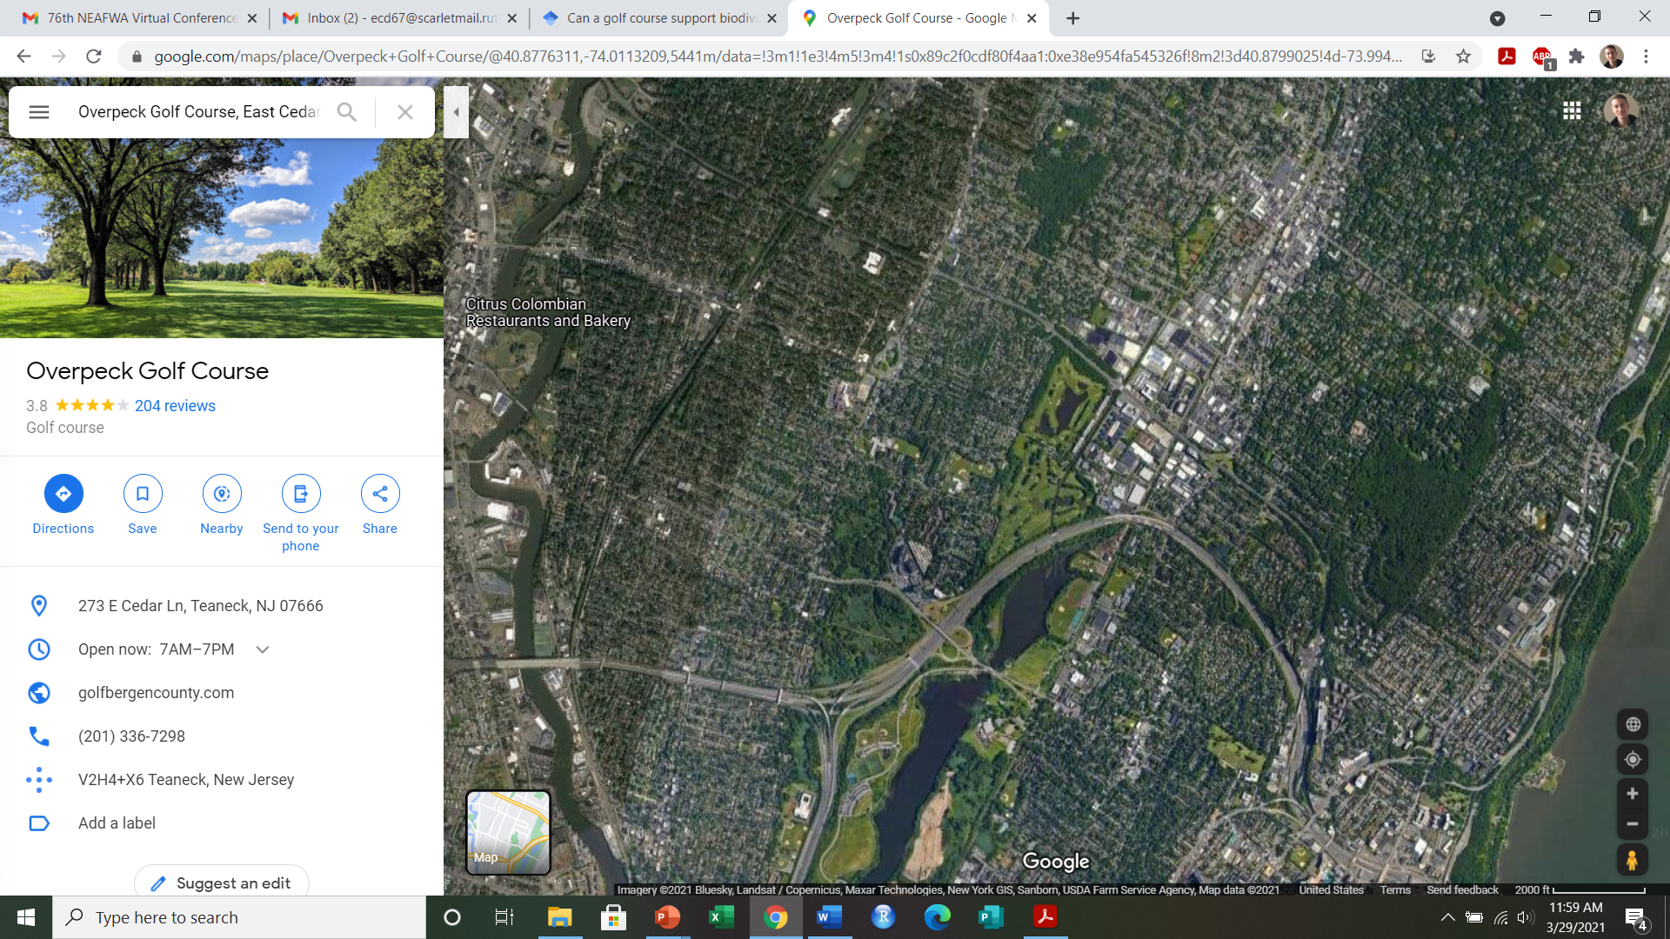
Landscape Matrix

Slide 6
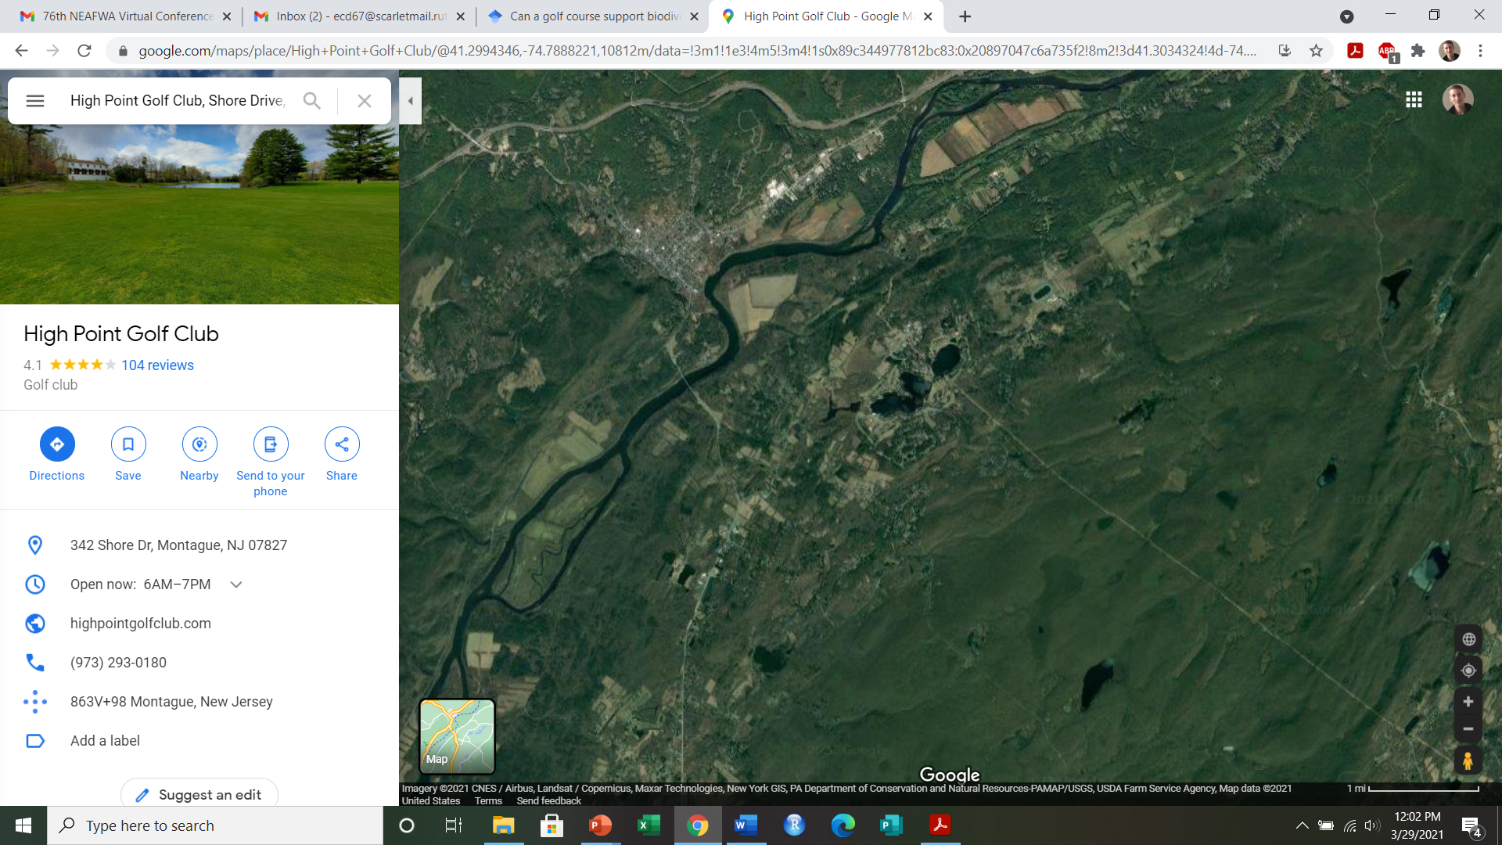
Landscape Matrix

Slide 7

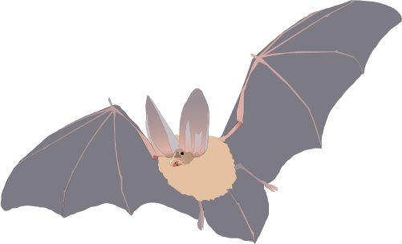

In what type of landscape are golf courses more important for bats?
Question
Passive acoustic monitoring
Manual echolocation analysis
GIS data
General activity models
Feeding activity models

Slide 8
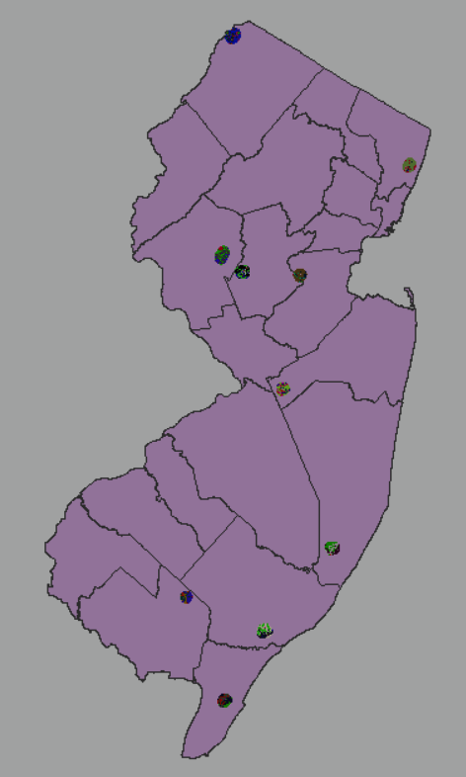
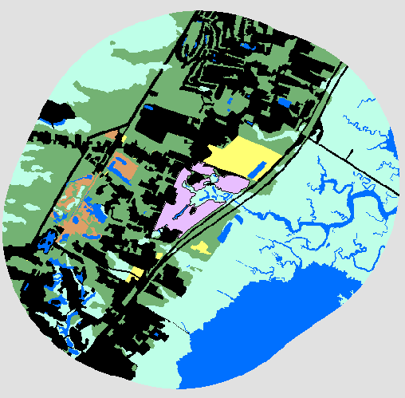
Study Sites
2km radius

Slide 9
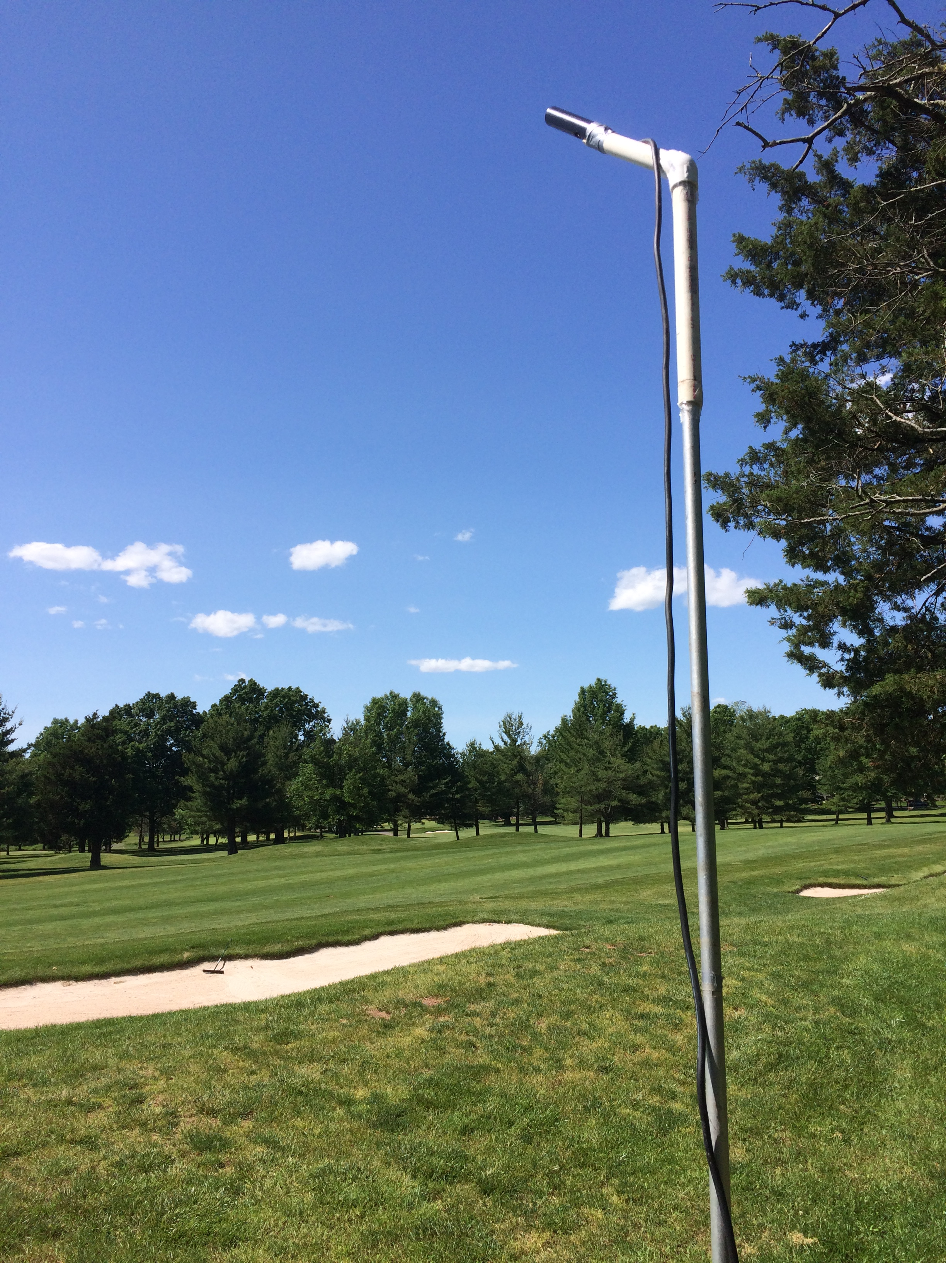
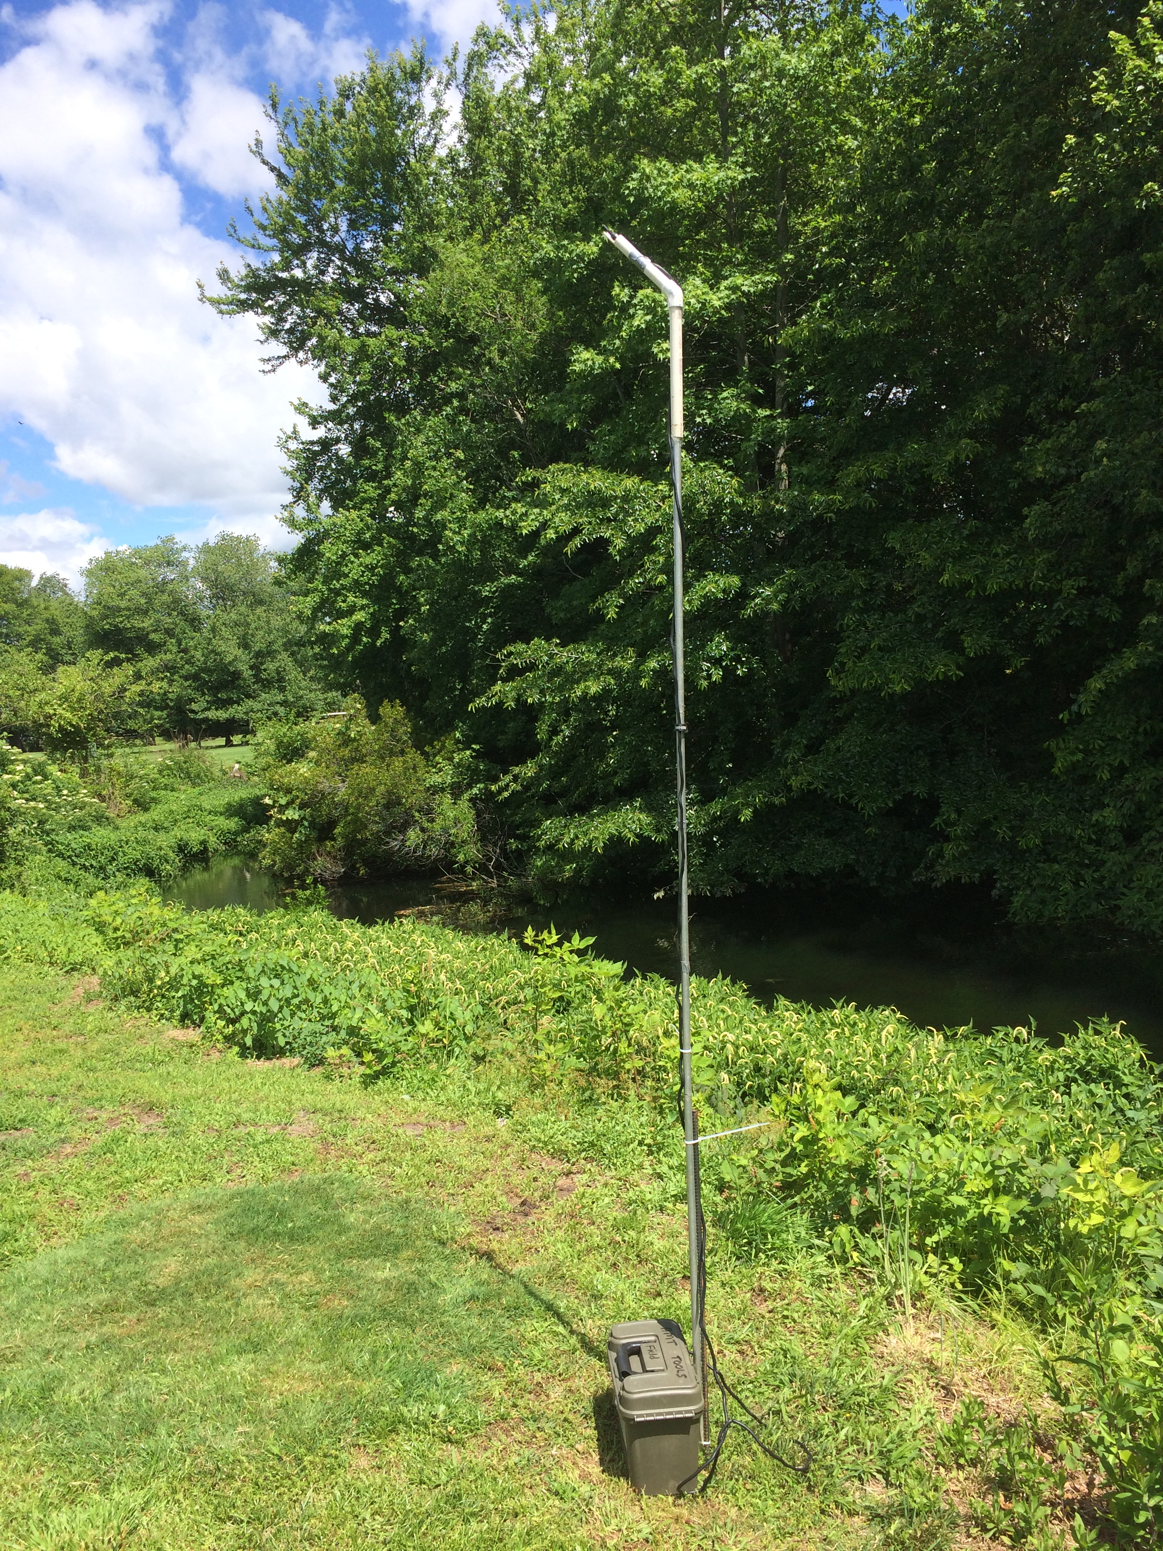
Acoustic Monitoring

Slide 10
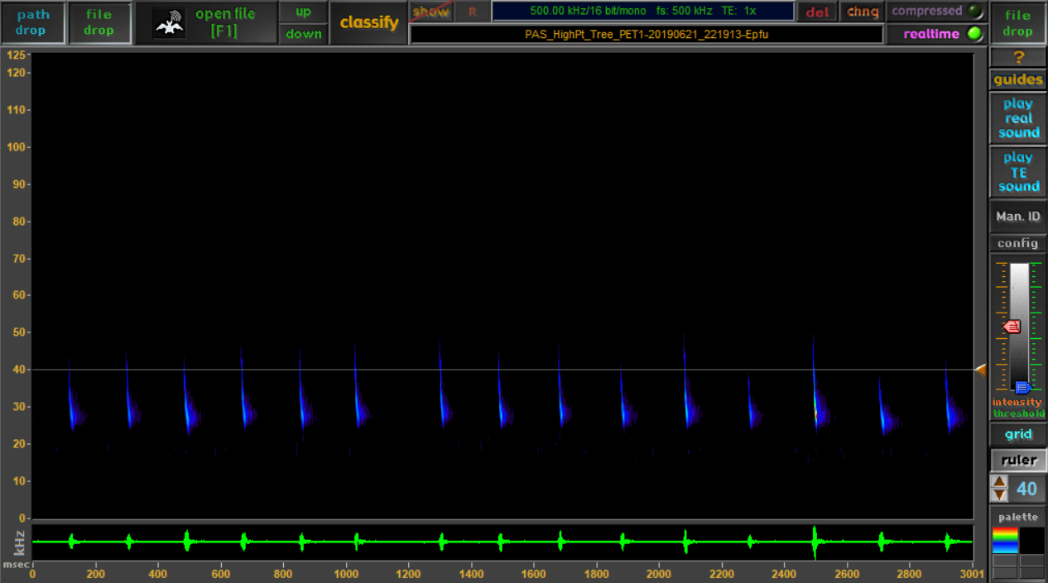
Echolocation Analysis

Slide 11
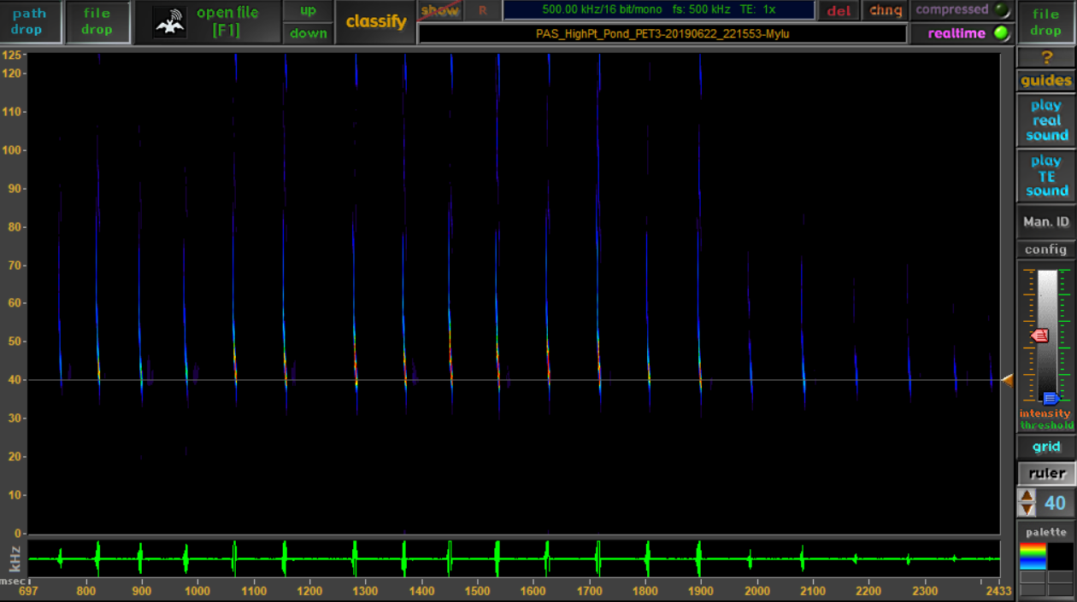
Echolocation Analysis

Slide 12
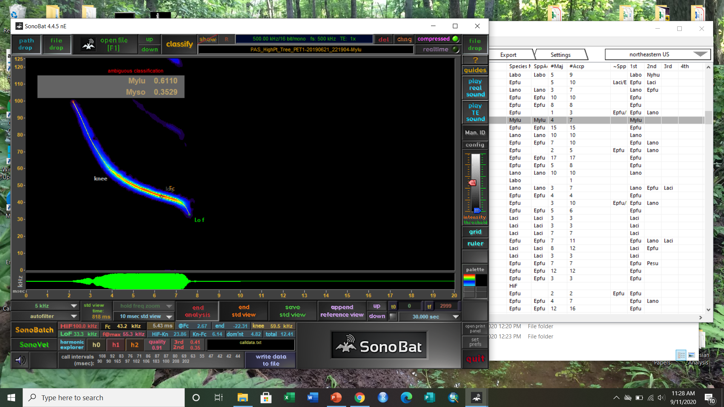
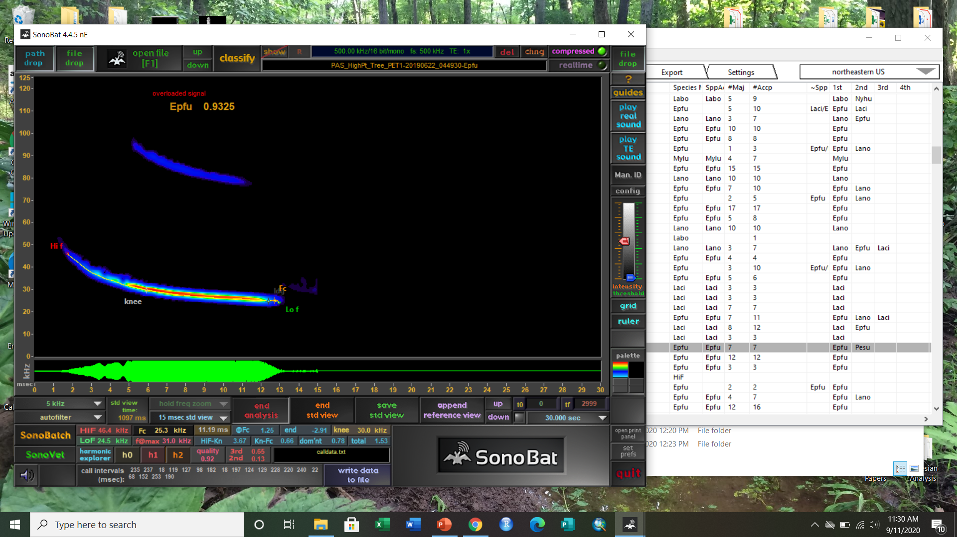
Echolocation Analysis

Slide 13
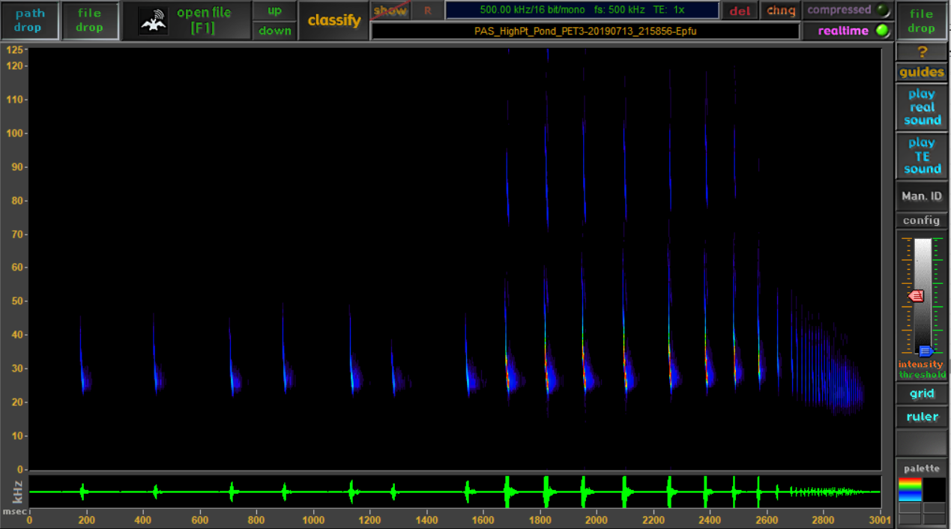
Echolocation Analysis

Slide 14
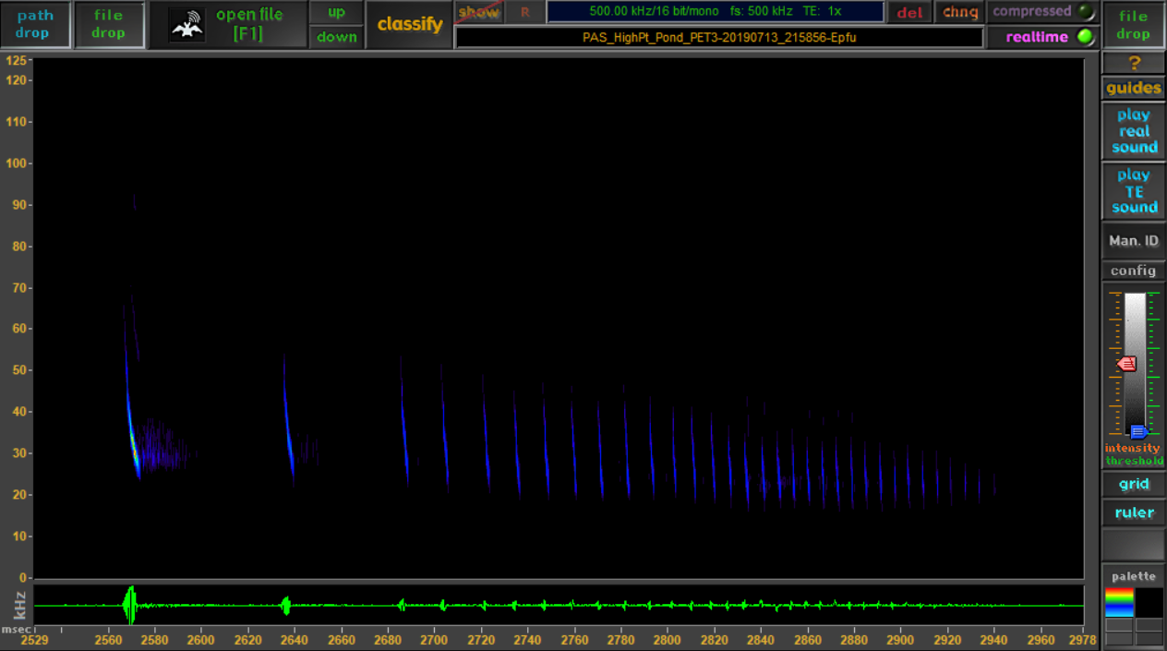
Echolocation Analysis

Slide 15
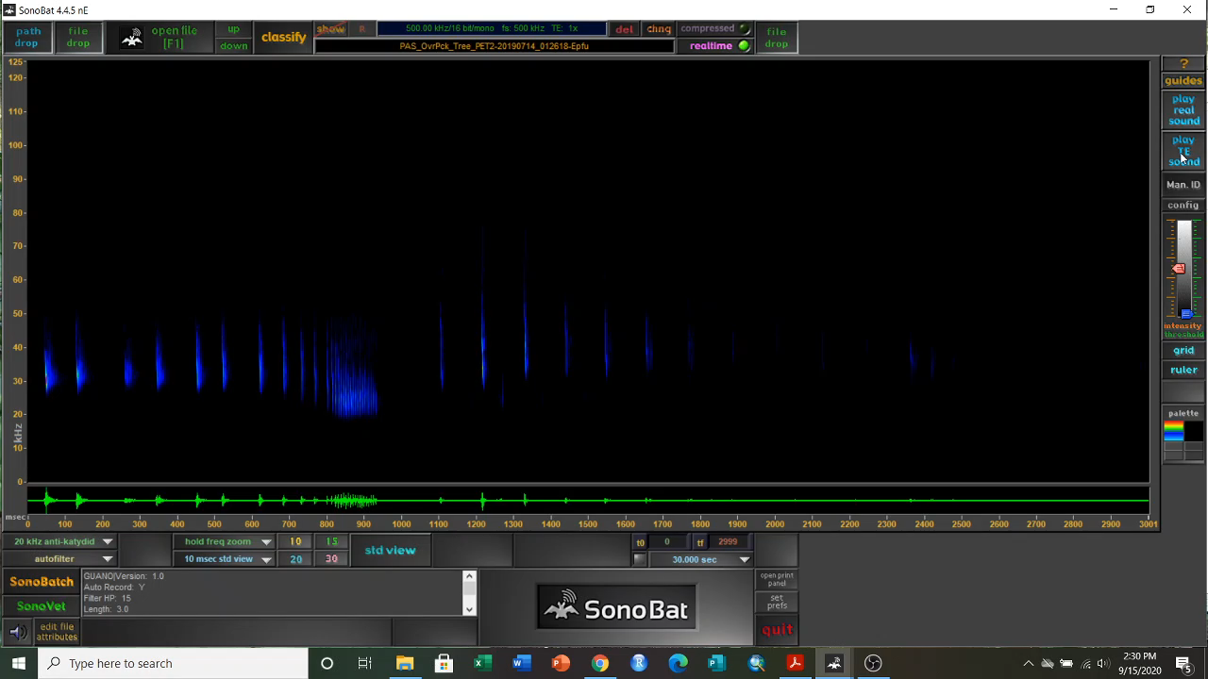
For your listening pleasure…

Slide 16
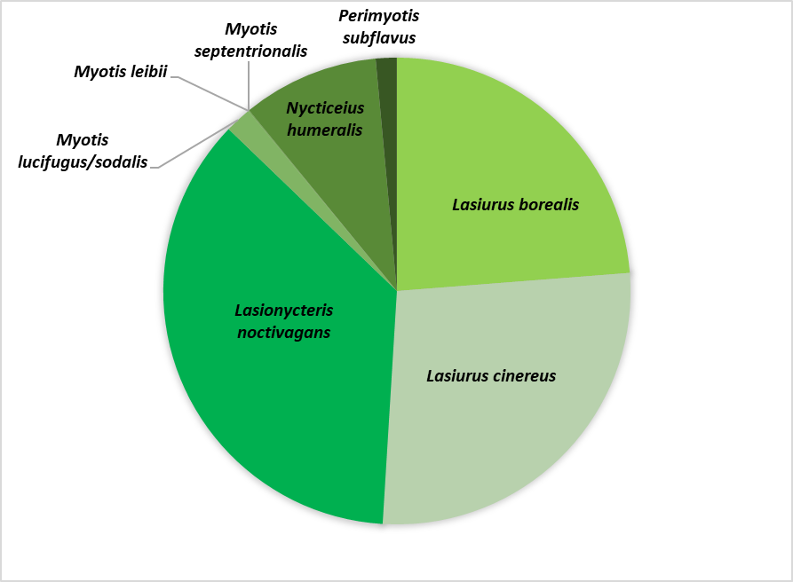
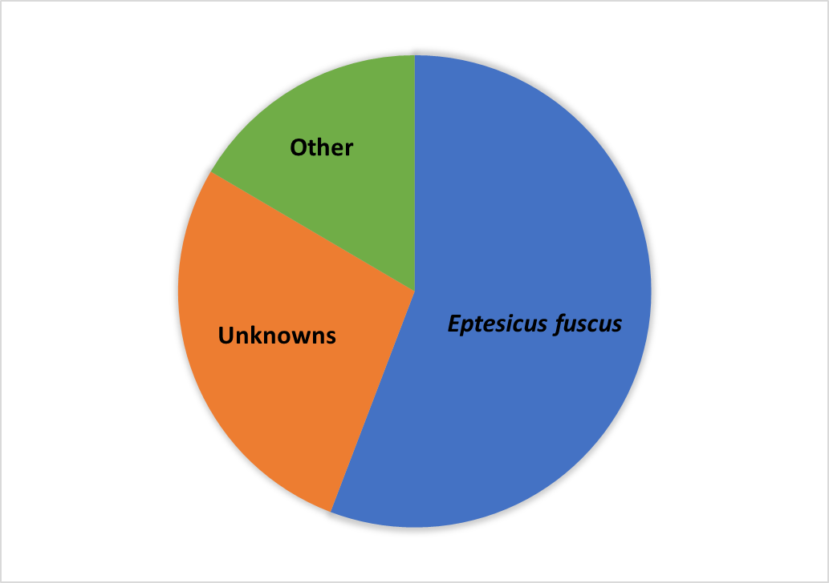
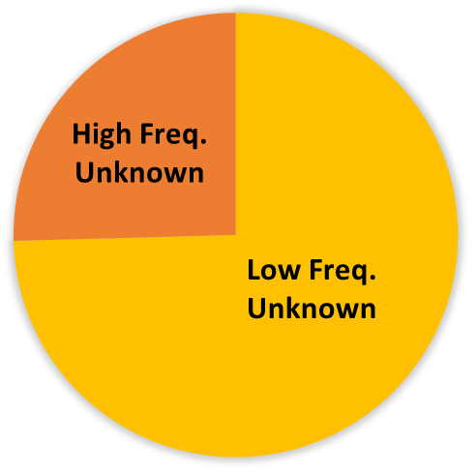

Slide 17
Activity Models
We treated each detector night on each course as a data point
How much total activity was observed?
How much activity per species?
How much foraging behavior was observed?
Response variables

Slide 18
Activity Models
Urban area %
Suburban area %
Agricultural land%
Open field%
Forested streams
Largest patch of forest
Pearson’s r < 0.70
Response variables
Predictor variables

Slide 19
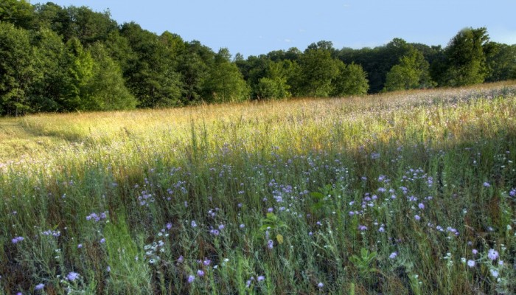
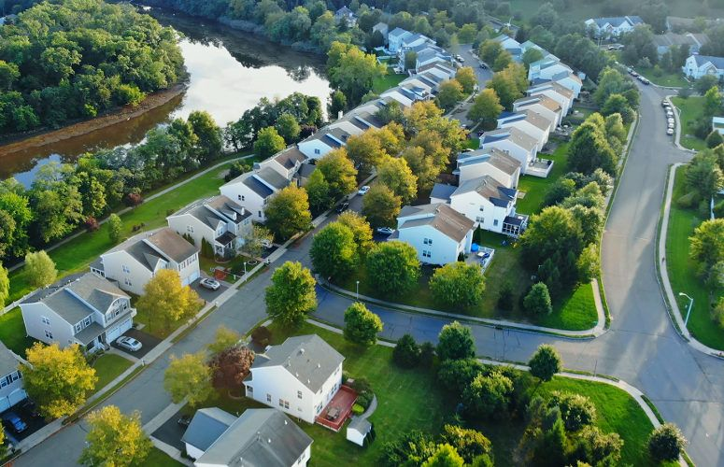
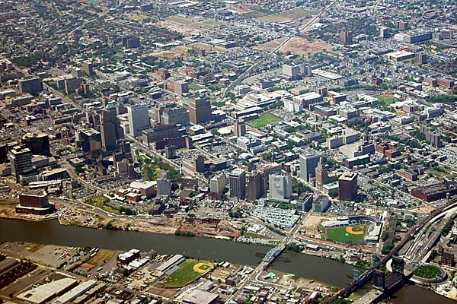
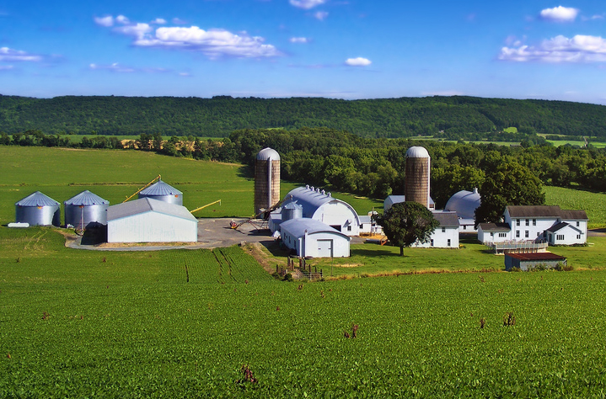
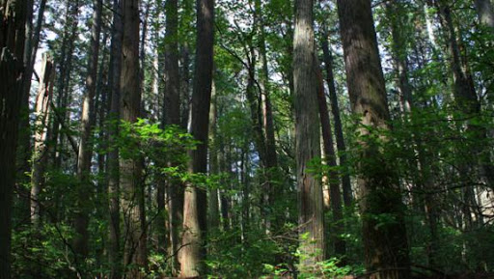
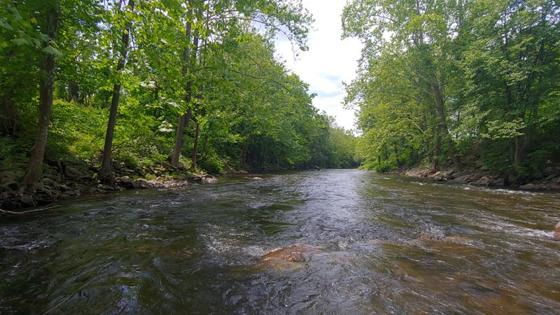
Activity Models
Urban area %
Suburban area %
Agricultural land%
Open field%
Forested streams
Largest patch of forest

Slide 20
Activity Models
I had repeated measures for each…
Year
Site
I used “lme4” package, command “glmer.nb()”
a negative binomial distribution for all models
Response variables
Generalized linear mixed-effects model
(GLMM)
Predictor variables
Random effects:
Year and Site

Slide 21
Activity Models
I used stepwise model selection:
Removed the variable with the lowest effect size until all remaining contributed significantly to the model
Compare with likelihood ratio test to make sure nothing important was removed (Package “lmtest”)
Response variables
Generalized linear mixed-effects model
(GLMM)
Predictor variables
Model selection
Interpret the winners
Random effects:
Year and Site

Slide 22
Golf Course vs. Landscape effects are species-dependent
Species-Specific Models
Species | Streams | Suburban | Fields | Agriculture | Forest LPI | Urban
Perimyotis subflavus | -7.68** |  |  | 4.02** | 6.30** | 5.18***
Myotis lucifugus/sodalis |  |  |  |  | 1.90*
Nycticeius humeralis | -8.12*** | 6.37*** | -0.96** | -2.85*** |  | -4.59***
Lasiurus borealis | -2.23*** | -1.49* | -1.97*** |  |  | 1.32*
Lasiurus cinereus | -2.26* |  | -1.00
Lasionycteris noctivagans |  |  | -1.26** | -0.67*
Eptesicus fuscus |  | 1.00*

Slide 23
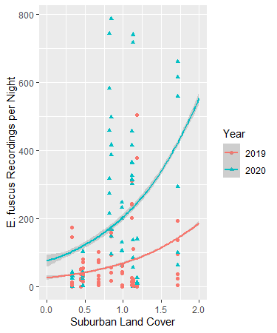
Activity Models
GLMMs were plotted using ggplot
Simulate the data over a range of a single predictor
epfu.pred.data.sub = expand.grid(SuburbanPct2km=seq(0,2,0.05),Year=unique(epfu$Year),Site=unique(epfu$Site))
Predict responses based on model
epfu.pred.data.sub$epfu5_pred = predict(epfu5, type = "response", newdata=epfu.pred.data.sub)
Plot the predictions over the data ggplot() + geom_point(data=epfu, aes(SuburbanPct2km, Act, shape=Year, col=Year)) +
geom_smooth(data=epfu.pred.data.sub, aes(SuburbanPct2km, epfu5_pred, col=Year),se=TRUE)+xlab("Suburban Land Cover")+ylab("E. fuscus Recordings per Night")

Slide 24

Bats come to golf courses when there is more roosting habitat nearby
Conclusions
Example: the big brown bat (Eptesicus fuscus)
Commonly roosts in attics and under loose siding
Even when natural roosts are available, it prefers buildings
Most abundant bat in NJ

Slide 25
Bats come to golf courses when there is more roosting habitat nearby
Conclusions
Example: the big brown bat (Eptesicus fuscus)
Commonly roosts in attics and under loose siding
Even when natural roosts are available, it prefers buildings
Most abundant bat in NJ
Species | Streams | Suburban | Fields | Agriculture | Forest LPI | Urban
Eptesicus fuscus |  | 1.00*

Slide 26
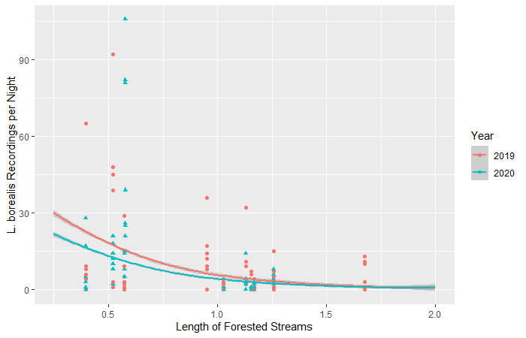
Activity Models

Slide 27

Bats come to golf courses when there is less foraging habitat nearby
Conclusions
Example: the eastern red bat (Lasiurus borealis)
A tree-roosting bat
Forages on forest edges, fields, and over water
Avoids urban areas

Slide 28
Bats come to golf courses when there is less foraging habitat nearby
Conclusions
Example: the eastern red bat (Lasiurus borealis)
A tree-roosting bat
Forages on forest edges, fields, and over water
Avoids urban areas
Species | Streams | Suburban | Fields | Agriculture | Forest LPI | Urban
Lasiurus borealis | -2.23*** | -1.49* | -1.97*** |  |  | 1.32*

Slide 29
Golf courses are more important when the surrounding landscape…
Conclusions
… provides more roosting habitat
… provides less foraging habitat
… differs from habitat provided by the golf course

Slide 30




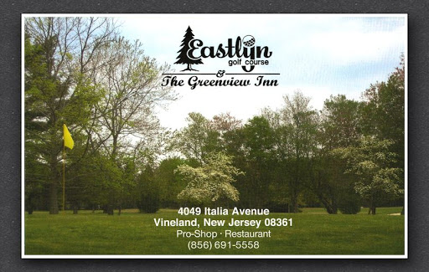



Thank you, to everyone working at the golf courses
Acknowledgements
and to everyone who helped give me ideas or tools
Bob Lowrie (Cream Ridge)
Lisa Jensen (Rutgers)
George Pierpoint (Harbor Pines)
Brad Miller (Sea Oaks)
Darrell Marcinek (Neshanic Valley)
Rob Arnts (Stanton Ridge)
Edd Becica (Avalon)
Rob Buono (Eastlyn)
Bret Roby (High Point)
Paul Park (Overpeck)
Scott Binkley (Atlantis)
Matt Waina
MacKenzie Hall
Jeff Brown
Mike Allen
Robert Kwait

